Slide 1
: Convex Hull construction via Star-Shaped Polyhedron in 3D
Flip- Flop
Mingcen Gao
Thanh-Tung Cao
Tiow-Seng Tan
Zhiyong Huang

Slide 2
Outline
Flips on 3D polyhedron
Flip-Flop: a novel flip algorithm
ffHull: 3D convex hull algorithm
Experiments

Slide 3
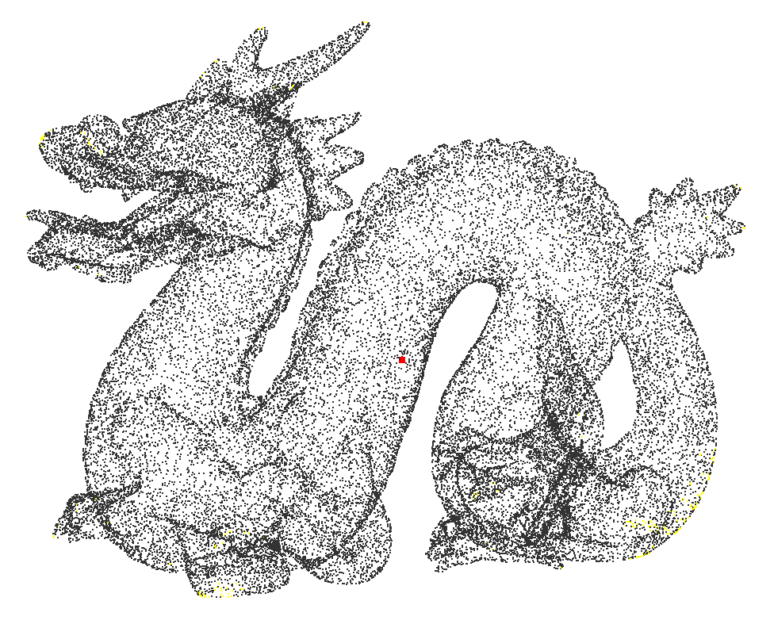
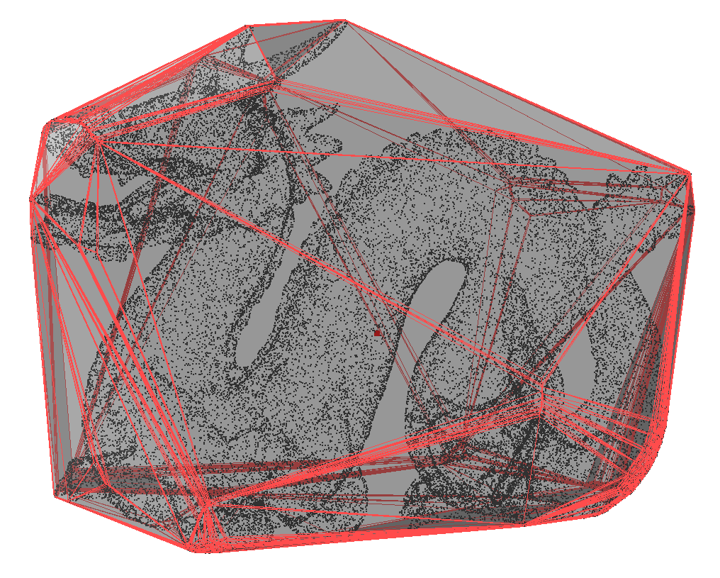
Flips on 3D polyhedron
1
Convex Hull in 3D
Point set
Convex Hull
Fundamental problem in CG
Collision detection
Path planning
CGAL (CPU)
qHull (CPU)
gHull (GPU) [Gao et al. 2012]

Slide 4
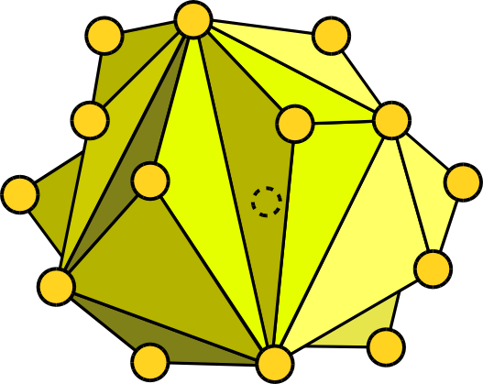
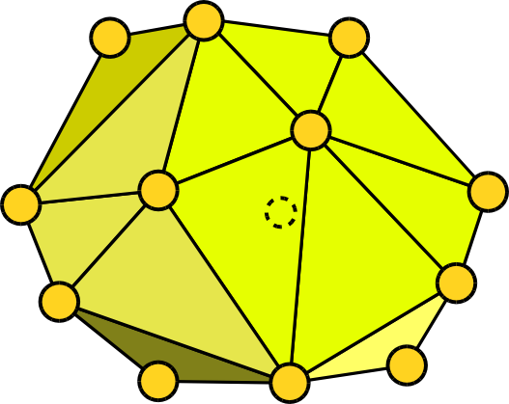
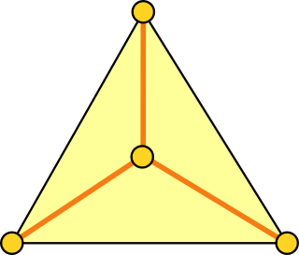
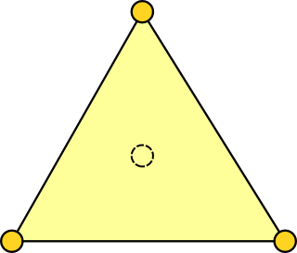
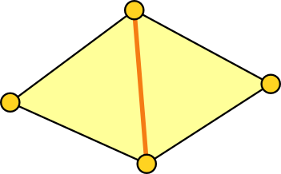
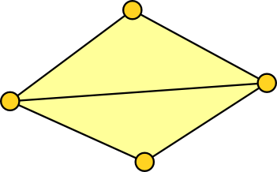
Flips on 3D polyhedron
1
Compute CH by flips
non-extreme points
reflex edges
Flips ?
Simple
Local
Parallel
some polyhedron
convex hull
3-1 flip
2-2 flip
3-1 Edge
2-2 Edge

Slide 5
Flips on 3D polyhedron
1
Compute CH by flips
Lawson’s flip algorithm
?
some polyhedron
convex hull
Difficulty 1: self-intersection
Greedy strategy: flip reflex edges only
Difficulty 2: stuck case

Slide 6
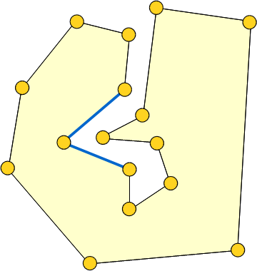
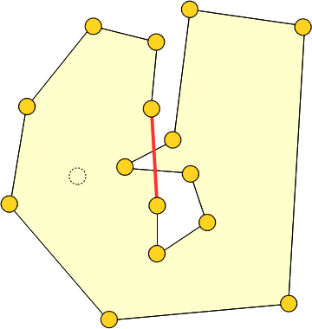
Flips on 3D polyhedron
1
Avoid self-intersection
Difficulty 1: Avoiding self-intersection
2D illustration
2-1 flip
Solution: star-shaped polyhedron

Slide 7
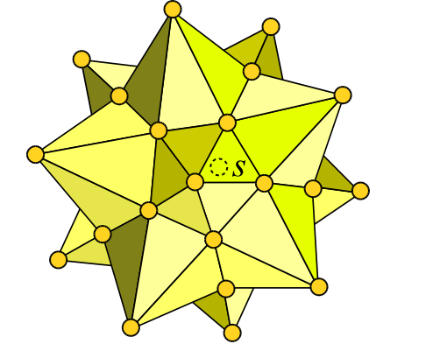
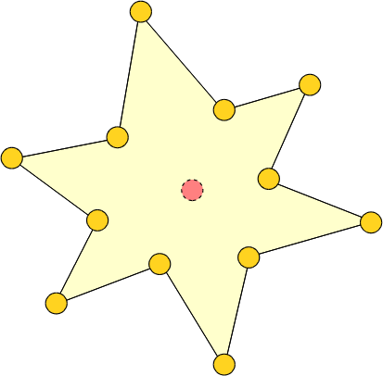
Flips on 3D polyhedron
1
Avoid self-intersection
Star-shaped polyhedron
s
Easy to construct from point set
2D
3D
In star-shaped polyhedron, checking whether a flip creates self-intersection is a local operation.

Slide 8
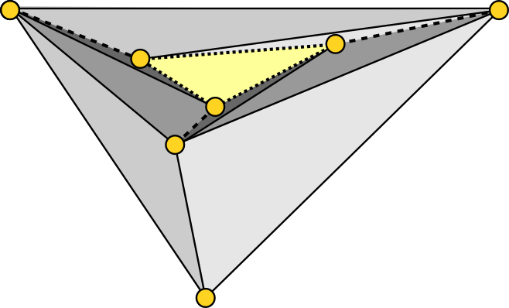
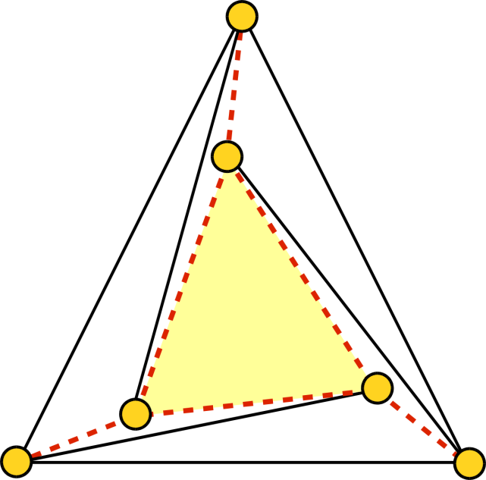
Flips on 3D polyhedron
1
Resolve stuck case
Difficulty 2: Resolving the stuck case
reflex edge
top view
Flipping any reflex edges creates self-intersection.
Solution: Flip-Flop (for star-shaped polyhedron)

Slide 9
Outline
Flips on 3D polyhedron
Flip-Flop: a novel flip algorithm
ffHull: 3D convex hull algorithm
Experiments

Slide 10
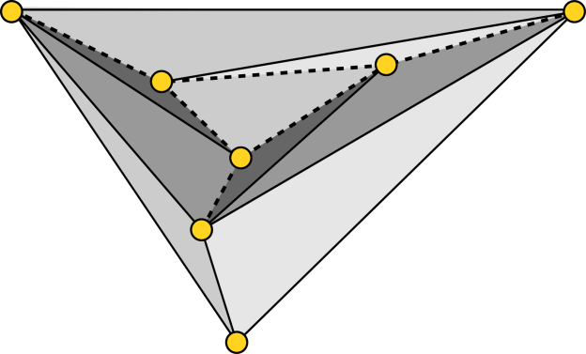
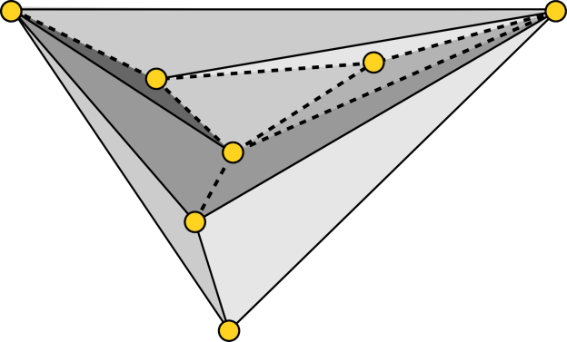
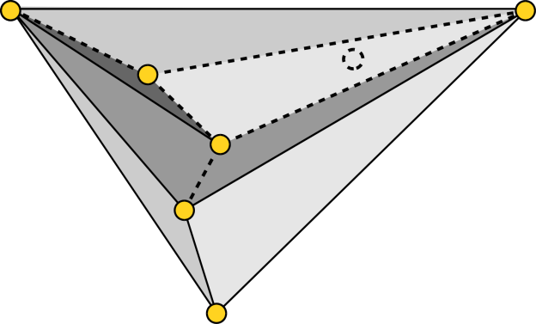
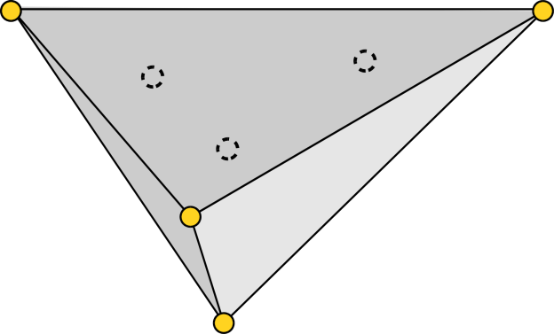
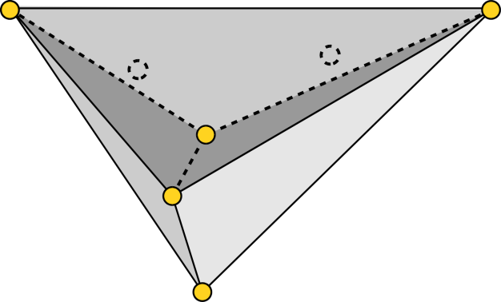
Flip-Flop: a novel flip algorithm
2
An example
b
d
a
b
a
e
e
d
f
f
3-1 flip on d
c
2-2 flip (cd → af)
c
b
d
a
p
p
e
non-extreme point
f
c
b
d
a
b
a
e
e
d
f
p
f
3-1 flip on e
c
3-1 flip on f
c
p
p

Slide 11
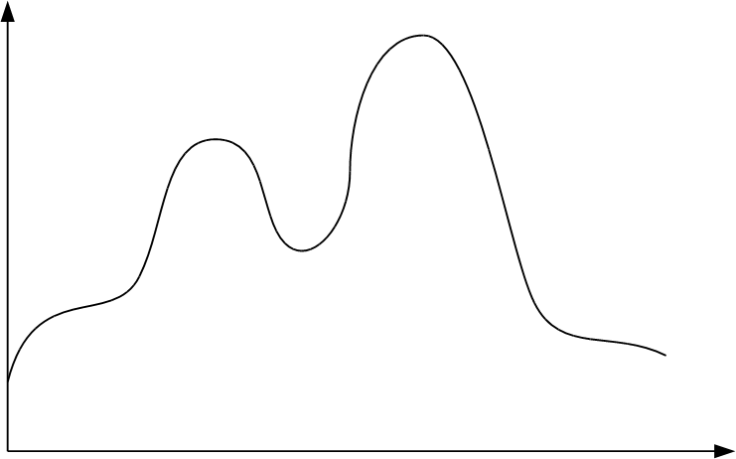
Flip-Flop: a novel flip algorithm
2
An example
Convex hull
Volume
Local optimum
“flip”
“flop”
Lawson’s flip
Flip-Flop
Flips

Slide 12
Flip-Flop: a novel flip algorithm
2
Concepts
Increase the volume by flips
Star-shaped
polyhedron
Flip-Flop
Convex hull
Find non-extreme points
Remove non-extreme points by flips

Slide 13
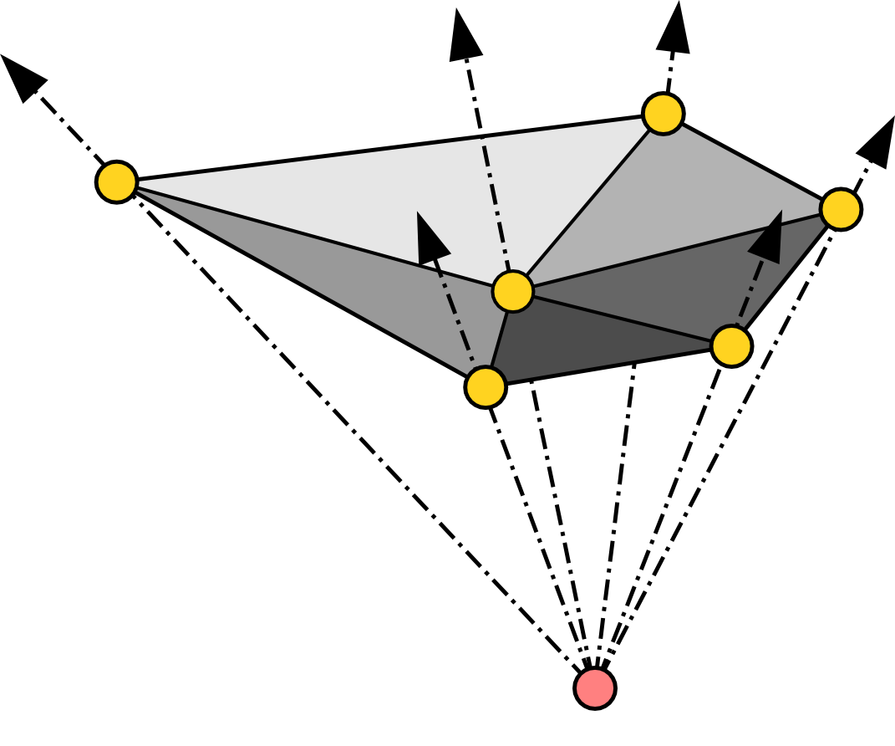
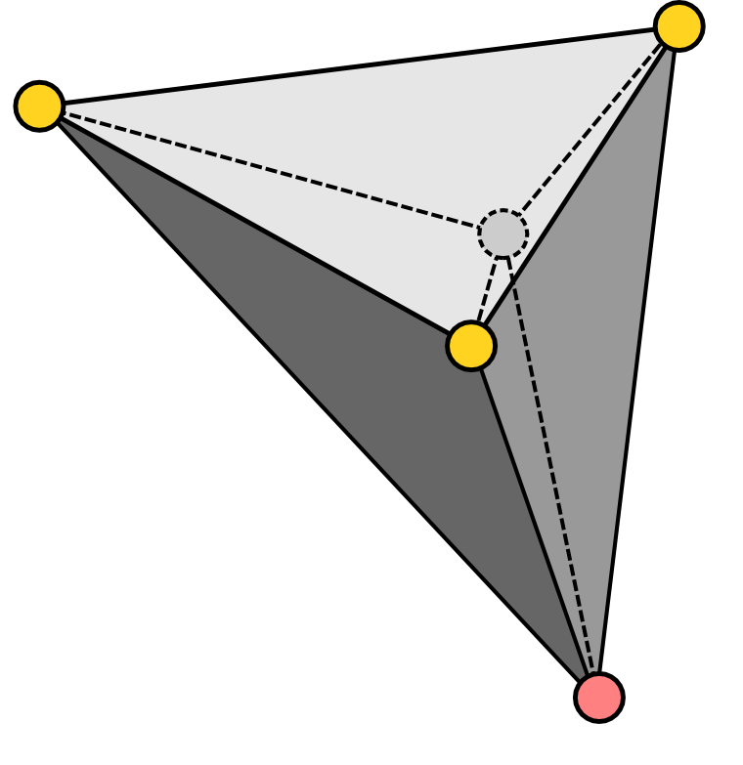
Flip-Flop: a novel flip algorithm
2
Find non-extreme points
a
a
b
v
b
v
c
c
s
s
2-2 edge bv cannot be flipped
bv is reflex
b and v lie in the same side of the plane sac
v is inside tetrahedron sabc
v is non-extreme

Slide 14
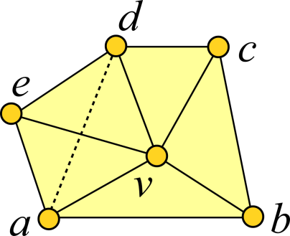
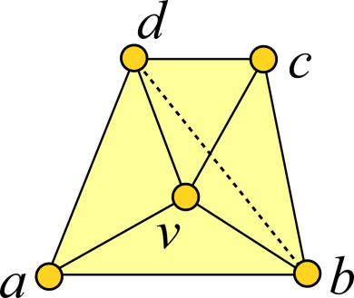
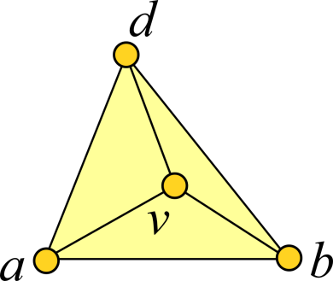
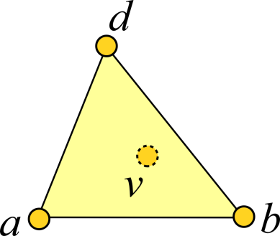
Flip-Flop: a novel flip algorithm
2
Remove non-extreme points
For a non-extreme point v, decreases its Degree by flipping the edges incident to it
degree(v)=5
degree(v)=4
degree(v)=3
degree(v)=0
If degree(v)=3, it can be removed by a 3-1 flip
v can be removed
If degree(v)>3, degree can be reduced by a 2-2 flip

Slide 15
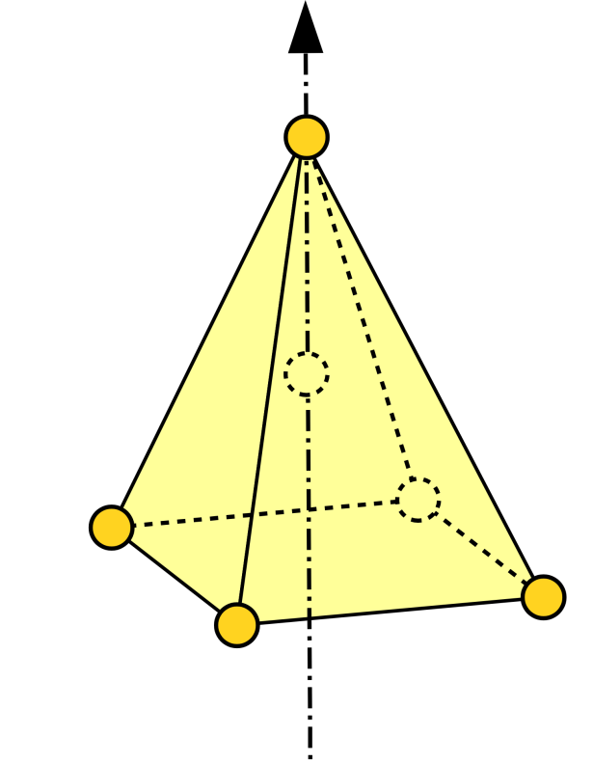
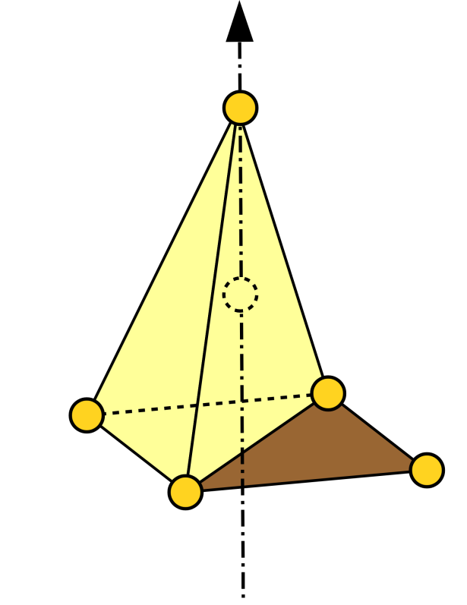
Flip-Flop: a novel flip algorithm
2
Remove non-extreme points
An edge can be flipped if the polyhedron is still star-shaped w.r.t. s after flipping it
v
v
flip va
s
s
c
b
c
b
a
a
d
d
no edge incident to v can be flipped
v is an extreme point!

Slide 16
Flip-Flop: a novel flip algorithm
2
GPU implementation
while it is not convex hull
▲
▲
▲
▲
▲
▲
▲
1. Identify and label non-extreme points.
2. If no edges need be flipped, stop the thread.
▲
▲
▲
△
▲
▲
△
Label the triangles included in the flip by atomic minimum operation.
▲
▲
▲
▲
▲
▲
▲
Flip the edge if all included triangles are still labeled by the thread.

Slide 17
Outline
Flips on 3D polyhedron
Flip-Flop: a novel flip algorithm
ffHull: 3D convex hull algorithm
Experiments

Slide 18
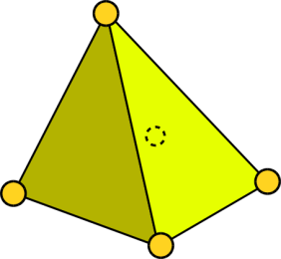
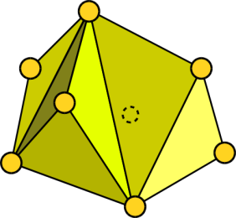
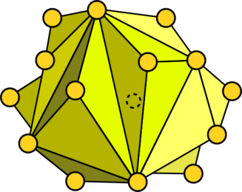
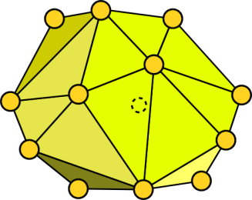
ffHull: 3D convex hull algorithm
3
Algorithm
Find 4 extreme points
Construct initial tetrahedron
Compute kernel point
Apply Flip-Flop
Point set
s
s
s
s
Star-shaped
polyhedron
Convex hull
Grow by parallel insertion with “furthest points” for every triangle

Slide 19
ffHull: 3D convex hull algorithm
3
GPU implementation
while it is not convex hull
▲
▲
▲
▲
▲
▲
▲
If the triangle are associated with some points, insert the “furthest” one.
▲
▲
▲
△
▲
▲
△
▲
▲
▲
▲
▲
▲
▲
▲
▲
▲
●
●
●
●
●
●
●
●
●
●
●
●
●
Update the associated triangle of the point if needed.

Slide 20
ffHull: 3D convex hull algorithm
3
Extensions
ffRT: 2D regular triangulation algorithm
Point set
Lift points by z=x²+y²-w
Compute lower hull
Compute many convex hulls concurrently
Point set 1
…
…
…
…
…
Point set n
Tetrahedron
Apply ffHull on all groups

Slide 21
Outline
Flips on 3D polyhedron
Flip-Flop: a novel flip algorithm
ffHull: 3D convex hull algorithm
Experiments

Slide 22
Experiments
4
Machine:
Intel i7 2600K 3.4GHz CPU
16GB of DDR3 RAM
NVIDIA GTX 580 Fermi GPU with 3GB of video memory

Slide 23
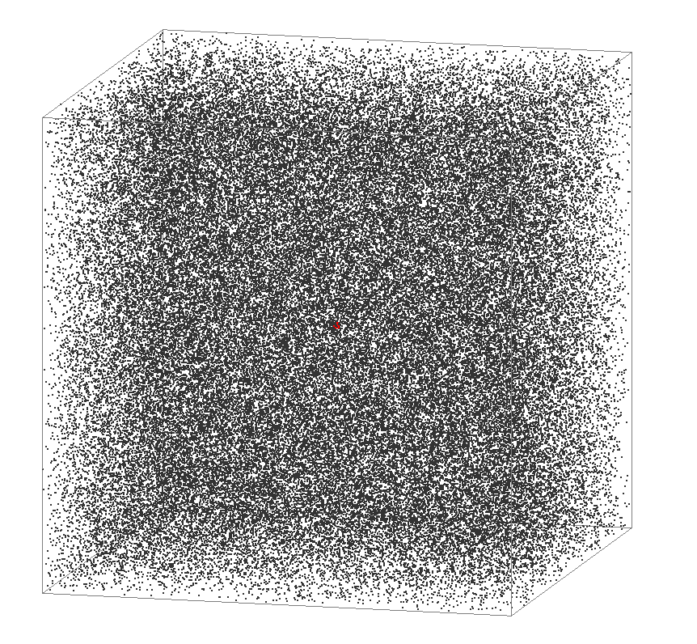
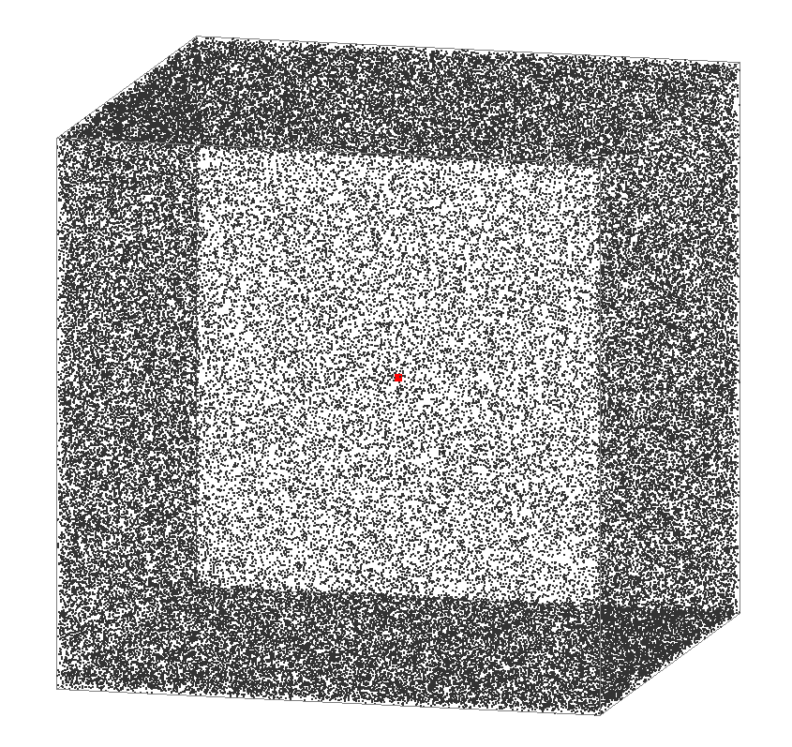
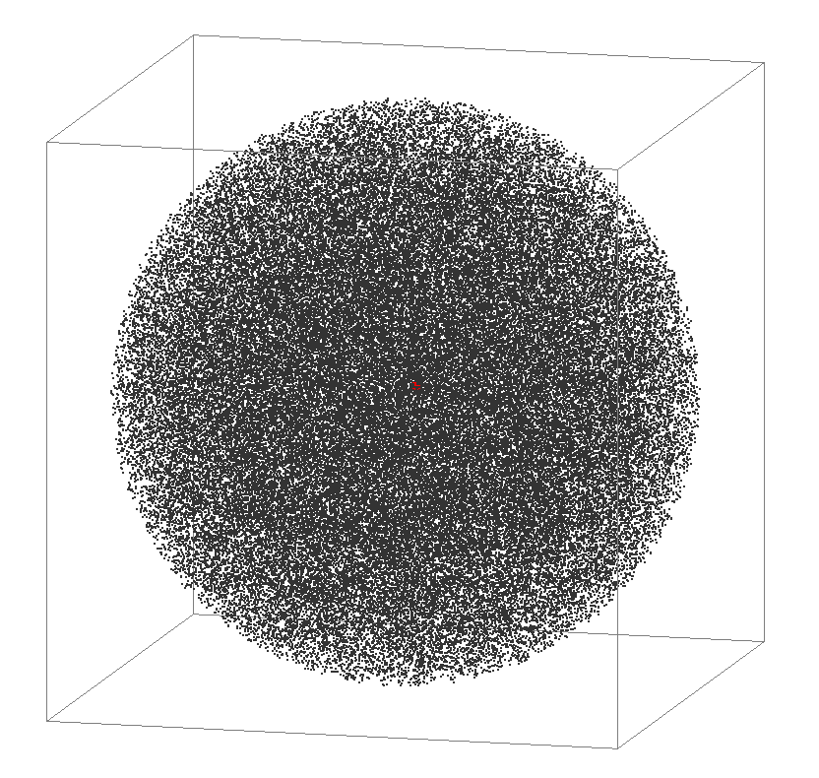
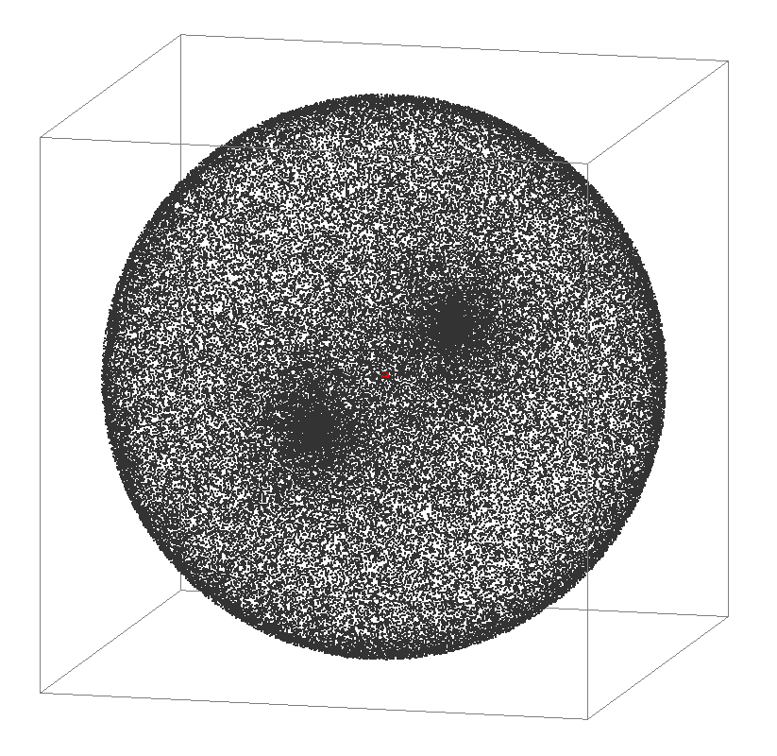
Experiments
4
Convex hull
Cube
Box (thickness 0.01)
2.4x↑ v.s. gHull
18x↑ v.s. qHull
66x↑ v.s. CGAL
3.2x↑ v.s. gHull
23x↑ v.s. qHull
75x↑ v.s. CGAL
Ball of radius 0.5
Sphere (thickness 0.01)
1.4x↑ v.s. gHull
20x↑ v.s. qHull
81x↑ v.s. CGAL
1.3x↑ v.s. gHull
30x↑ v.s. qHull
110x↑ v.s. CGAL

Slide 24
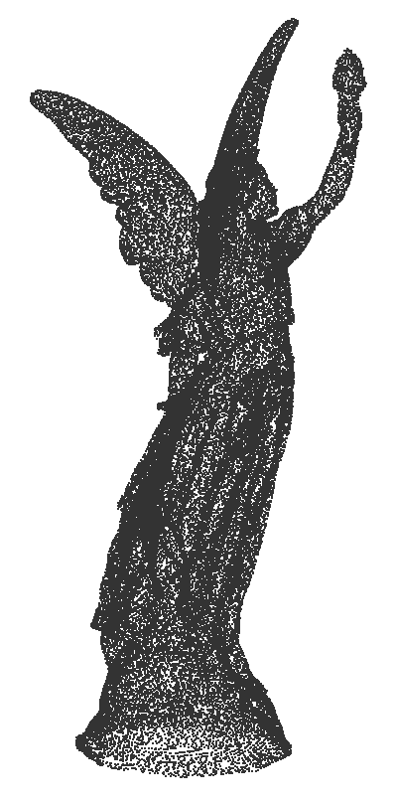
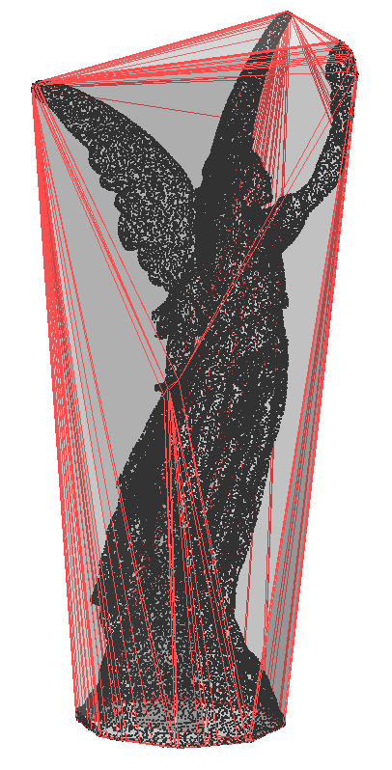
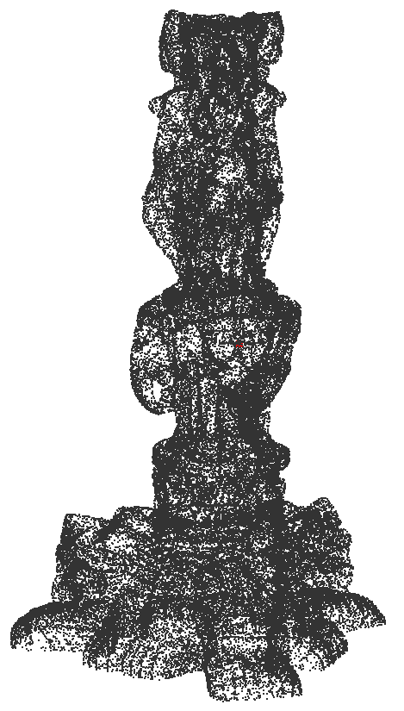
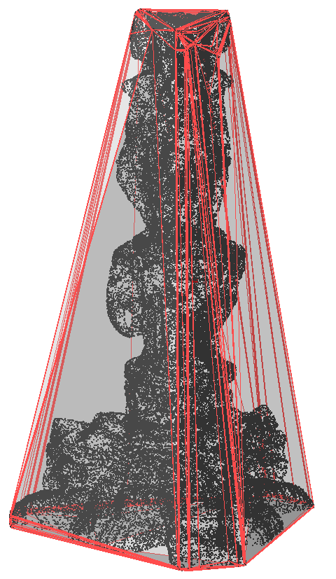
Experiments
4
Convex hull
Thai statue
Lucy
1.4x↑ v.s. gHull
5.5x↑ v.s. qHull
12x↑ v.s. CGAL
1.1x↑ v.s. gHull
7.2x↑ v.s. qHull
17x↑ v.s. CGAL

Slide 25
Conclusions
5
is provably correct
uses only local operations
Flip-Flop
GPU friendly
allows any order of flips
works for any star-shaped polyhedron
ffHull
ffRT
GPU friendly
GPU friendly

Slide 26
Thank You!
Q & A
mingcen@comp.nus.edu.sg
http://www.comp.nus.edu.sg/~tants/flipflop.html

