Slide 1

A simple equation for citation curves
Y.C. Tay
National University of Singapore
in collaboration with :
Mostafa Rezazad, School of Computer Science, Institute for Research in Fundamental Sciences (IPM), Tehran, Iran
Hamid Sarbazi-Azad, Sharif Univ. of Technology and Institute for Research in Fundamental Sciences (IPM), Tehran, Iran

Slide 2
modeling empirical data
this talk: citation data

Slide 3
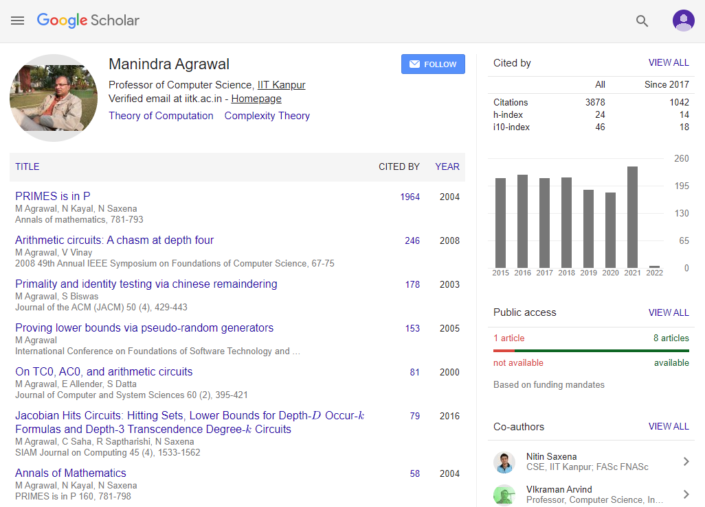

Slide 4
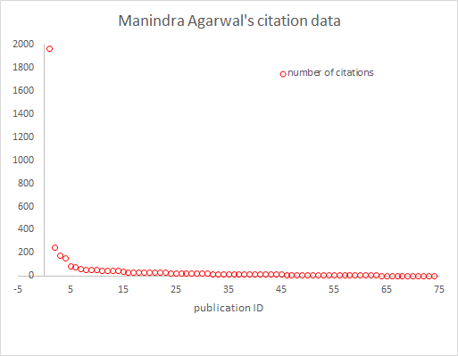
model for this data?

Slide 5
what is the h-index?
health scientist
y = x
14
14
h-index = 14

Slide 6

why care about h-index?
it is used to compare
• researchers

Slide 7

why care about h-index?
it is used to compare
• researchers
• journals

Slide 8

why care about h-index?
it is used to compare
• researchers
• journals
• departments

Slide 9
why care about h-index?
it is used to compare
• researchers
• journals
• departments
• countries
there are issues with the h-index

Slide 10

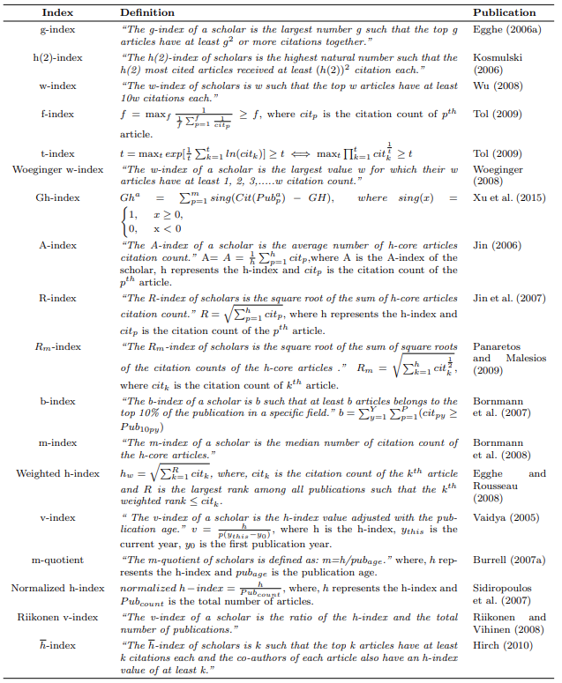
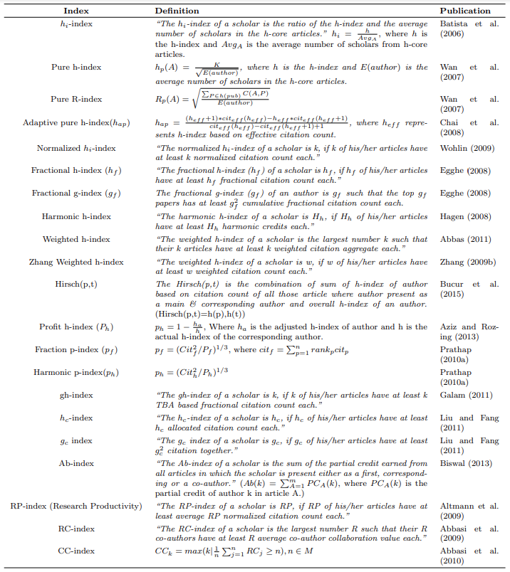
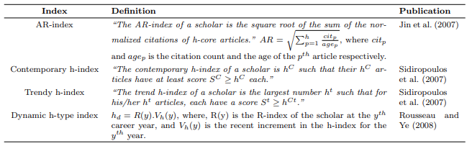
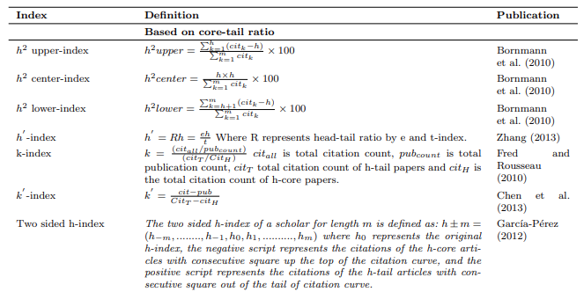
how to analyze their relationships?

Slide 11
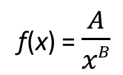


usual model: power law
f(x)
• bad limit behavior
$$\lim_{x→0}{f\left(x\right)= ∞}$$
f(x) = $\frac{A}{xB}$
0
x
$$f\left(x\right)>0 for all x$$

Slide 12
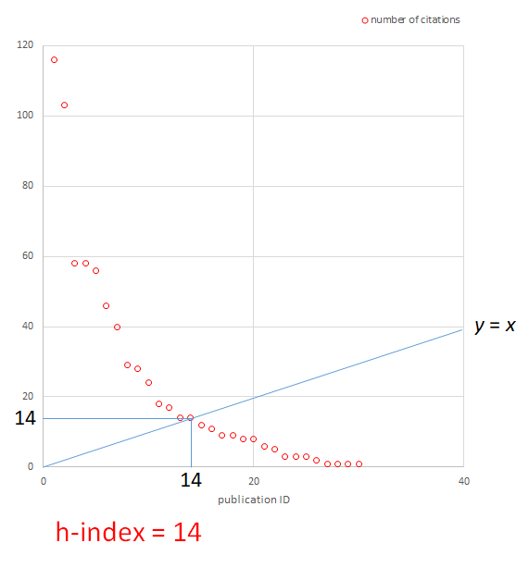

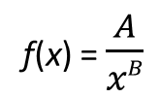


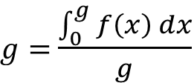
usual model: power law
• bad limit behavior
f(x) = $\frac{A}{xB}$
$$\left(\frac{B−1}{B}\right)$$
• not tractable
$$g=h\left(\frac{B−1}{B−2}\right)$$
h-index:
$$h=f(h)$$
$g=$ $\frac{\int_{0}^{g}{f\left(x\right) dx}}{g}$
relationship?
g-index:

Slide 13
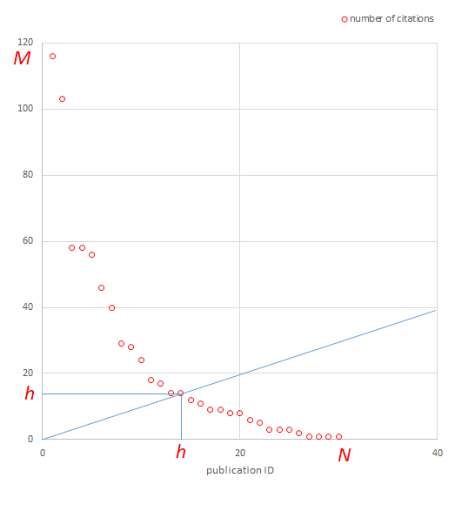
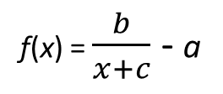
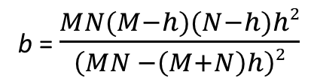
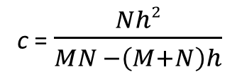
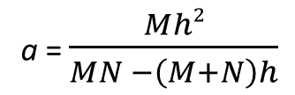
our simple model:
start from the empirical data
M = maximum number of citations
N = number of publications
f(x)
f(0) = M
a = $\frac{Mh2}{MN −\left(M+N\right)h}$
M
b = $\frac{MN(M−h)(N−h)h2}{\left(MN −\left(M+N\right)h\right)2}$
f(x) = $\frac{b}{x+c}$ - a
f(h) = h
c = $\frac{Nh2}{MN −\left(M+N\right)h}$
h
f(N) = 0
-c
x
h
N
-a

Slide 14
our simple model:
start from the empirical data
does the model fit the data?

Slide 15
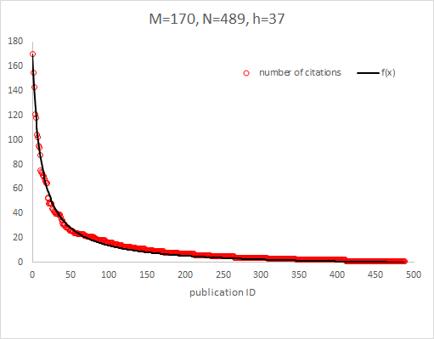
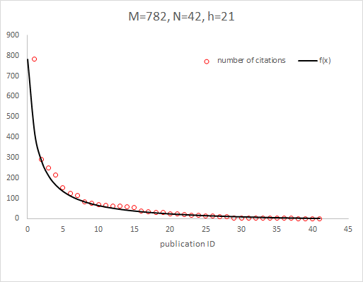
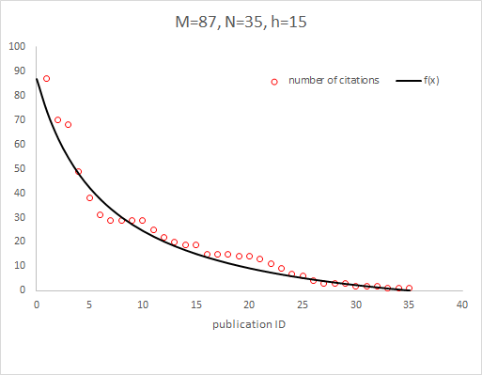
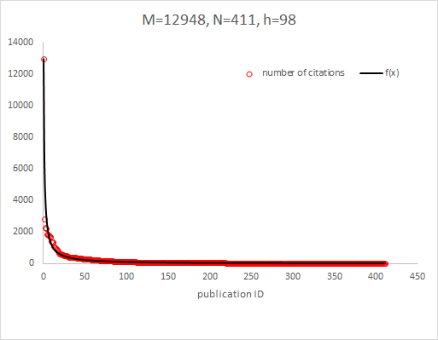
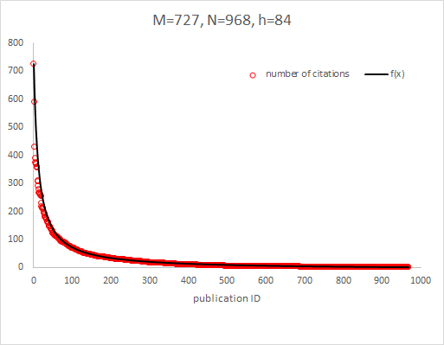
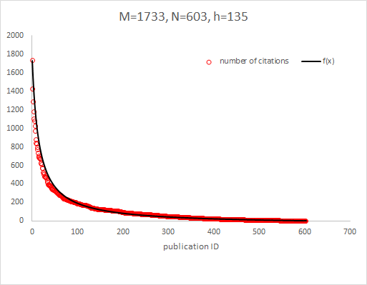
computer architecture
chemical engineering
bioenergy
machine learning
computer networks
pharmacoepidemiology

Slide 16
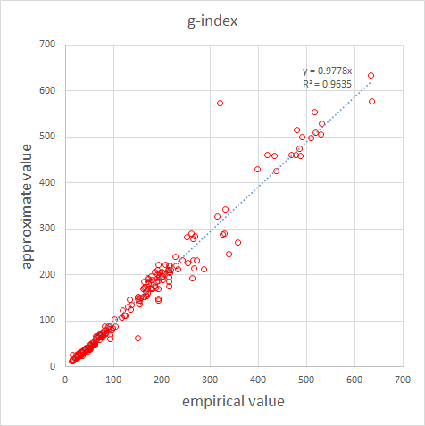
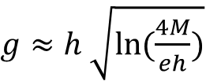
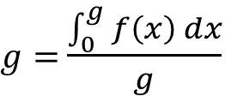
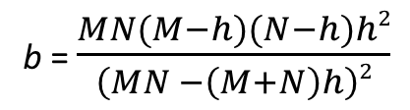
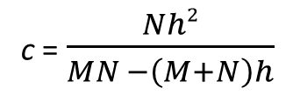
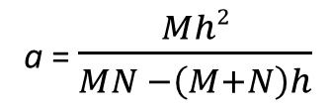
our simple model:
start from the empirical data
tractable?
f(x)
226 authors (1 point per author)
a = $\frac{Mh2}{MN −\left(M+N\right)h}$
b = $\frac{MN(M−h)(N−h)h2}{\left(MN −\left(M+N\right)h\right)2}$
M
f(x) = $\frac{b}{x+c}$ - a
$g≈h \sqrt{ln⁡(\frac{4M}{eh})}$
c = $\frac{Nh2}{MN −\left(M+N\right)h}$
2.71828...
h
$g=$ $\frac{\int_{0}^{g}{f\left(x\right) dx}}{g}$
g-index:
-c
x
compare to power law model:
h
N
-a
f(x) = $\frac{A}{xB}$
$$\left(\frac{B−1}{B}\right)$$
$$g=h\left(\frac{B−1}{B−2}\right)$$

Slide 17


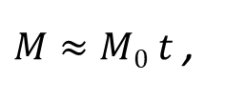
our simple model:
start from the empirical data
tractable?
f(x)
a = $\frac{Mh2}{MN −\left(M+N\right)h}$
b = $\frac{MN(M−h)(N−h)h2}{\left(MN −\left(M+N\right)h\right)2}$
constant?
M
f(x) = $\frac{b}{x+c}$ - a
$g≈h \sqrt{ln⁡(\frac{4M}{eh})}$
$=h \sqrt{ln⁡(\frac{4M0}{eh0})}$
c = $\frac{Nh2}{MN −\left(M+N\right)h}$
constant
h
$g=$ $\frac{\int_{0}^{g}{f\left(x\right) dx}}{g}$
there is some empirical evidence for linear model:
g-index:
-c
x
$M≈M0 t$ ,
$$h≈h0 t$$
h
N
-a
time
constant

Slide 18
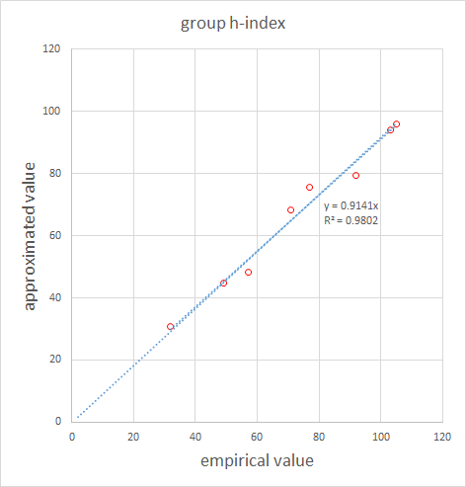

our simple model:
start from the empirical data
group h-index h* for r authors:
<M₁,N₁, h₁>, <M₂,N₂, h₂>, ..., <M_{r},N_{r}, h_{r}>
tractable?
f(x)
a = $\frac{Mh2}{MN −\left(M+N\right)h}$
b = $\frac{MN(M−h)(N−h)h2}{\left(MN −\left(M+N\right)h\right)2}$
M
f(x) = $\frac{b}{x+c}$ - a
c = $\frac{Nh2}{MN −\left(M+N\right)h}$
h
r = 2
x
r = 9
-c
h
N
-a

Slide 19
f(x)
conclusion:
a = $\frac{Mh2}{MN −\left(M+N\right)h}$
simple model
(starting from empirical data M, N, h)
tractable
(for design/analysis of citation data/indices)
b = $\frac{MN(M−h)(N−h)h2}{\left(MN −\left(M+N\right)h\right)2}$
M
f(x) = $\frac{b}{x+c}$ - a
c = $\frac{Nh2}{MN −\left(M+N\right)h}$
h
-c
x
h
N
-a

Slide 20


