Slide 1
A Social Network is not a Graph
Y.C. Tay
National University of Singapore
in collaboration with : Zhifeng Bao, Yong Zeng, Jingbo Zhou

Slide 2
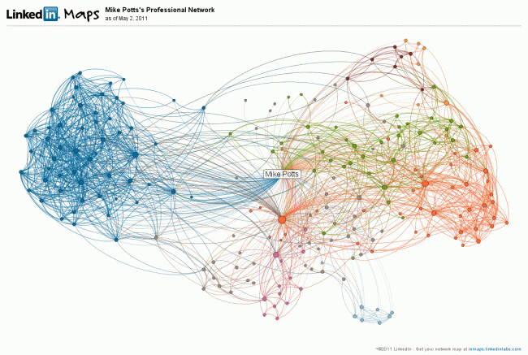
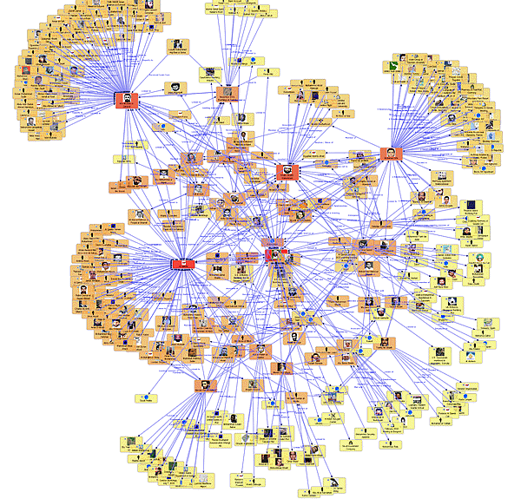

(fmsasg.com)

Slide 3
papers
Tripartite Graph Clustering for Dynamic Sentiment Analysis on Social Media
courses
CS104 Information and Information Systems
Social Networks and Graph Theory
books
Exponential Random Graph Models for Social Networks

Slide 4
but a social network
is not a graph

Slide 5
a social network is not a graph because
(1) a social network is dynamic but a graph is static
Facebook:
TAO social graph
(Bronson et al,
USENIX ATC 2013)
pulled
graph is not up-to-date
updates
master
database

Slide 6
a social network is not a graph because
(2) a social network is multi-dimensional
whereas a graph is one-dimensional
(fmsasg.com)

Slide 7
a social network is not a graph because
(2) a social network is multi-dimensional
whereas a graph is one-dimensional
hobby
job
node
attributes
Aisha
Bala
family
education
Facebook friends
tag
Twitter follower
comment
edge attributes

Slide 8
a social network is not a graph because
(2) a social network is multi-dimensional
whereas a graph is one-dimensional
Link Prediction Problem (e.g. "People You May Know")
e.g. [Lichtenwalter et al, KDD2010]
[Liben-Nowell & Kleinberg CIKM2003]
Prob(link) = f (node degree, path length, ...)
graph
algorithms
graph properties
one dimension
much better [Bao et al, ASONAM2013] :
academic community
Prob(link) = f (coauthor, citation, affiliation, ...)
principal
component
analysis
multi-dimension

Slide 9
a social network is not a graph because
(2) a social network is multi-dimensional
whereas a graph is one-dimensional
Cluster Discovery
e.g. [Leskovec et al, WWW 2008]
[Mishra et al, Internet Math 2008]
algorithm(conductance, betweenness, ...)
syntactic graph properties
much better [Bao et al, ER2013] :
academic community
algorithm(number and frequency of interactions)
semantics of relationship

Slide 10
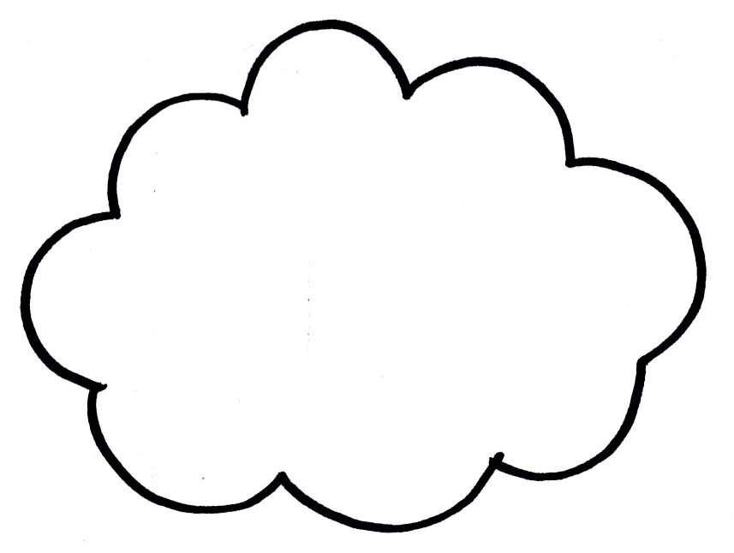
a social network is not a graph because
(3) a social network contains many graphs
e.g. [Zhou & Lin, KDD2013]
data model: social graph + interaction graph + influence graph
e.g. social network for photographs:
bird watchers, gourmet cooks, photo journalists, Bollywood fans, ...
e.g. Facebook's TAO graph: thousands of edge types
type = gender:
female
graph
male

Slide 11
a social network is not a graph because
(4) social network analysis often not expressible as graph navigation
e.g. How do coauthor communities evolve over time?
sample SQL query to find #coauthors for papers in SIGMOD conferences
between 1995 and 2000:
select count(*) from coauthor, proceedings p, conference c
where coauthor.paper_id = p.paper_id
and p.proceeding_id = c.proceeding_id
and year(c.publication_date) > 1995
and year(c.publication_date) <= 2000
and c.proc_profile like `%SIGMOD'
requires aggregation, joins, selection, non-key attributes.
expressible as graph traversal?

Slide 12
a social network is not a graph because
(5) hard to express/impose data integrity constraints on a graph model
foreign keys
e.g. tagging a face in a photo:
tag.photo_id must be a photo.photo_id
functional dependencies
e.g user_id uniquely determines name
etc.

Slide 13
a social network is not a graph because
(6) there are no industrial strength graph data management systems
system catalog
buffer management
triggers
data dictionary language
concurrency control
stored procedures
data normalization
crash recovery
index structures
access control
data warehousing
query optimization
view materialization
decision support
integrity constraints
data sharding/replication
data mining

Slide 14
if not a graph,
then what?

Slide 15
We want a data model for social networks that
(I) is supported by commercial database management systems
e.g. DB2, SQL Server, Oracle
(II) is supported by database management systems
that are affordable for social network start-ups
e.g. MySQL, PostgreSQL
(III) facilitates database schema design for social networks
(IV) facilitates database system engineering for scalability
our proposal: sonSchema
a relational database model of restricted form
(I), (II)
(III), (IV)

Slide 16
sonSchema :
a relational database model of restricted form
starting point: what is a social network?
a social network is a group of users
who interact through social products
sonSchema
entities
relationships
user
friendship
user
user-user
group
membership
post
response2post
product-product
product
private_message
product_relationship
social_product
product_activitiy
user-product

Slide 17
logical
schema
conceptual
schema
example
instantiations
example
instantiations
sonSchema
individual
entities
relationships
advertiser
contact_list
user
friendship
follower
cricket_club
Beatles_fans
group
membership
comment
photo
post
response2post
retweet
blog
coupon-event
email
private_message
product_relationship
vote-election
announcement
social_product
product_activitiy
tag_photo
coupon
share_video
poll
event
like_comment

Slide 18
sonSchema
conceptual schema:
secondary key
primary key

Slide 19
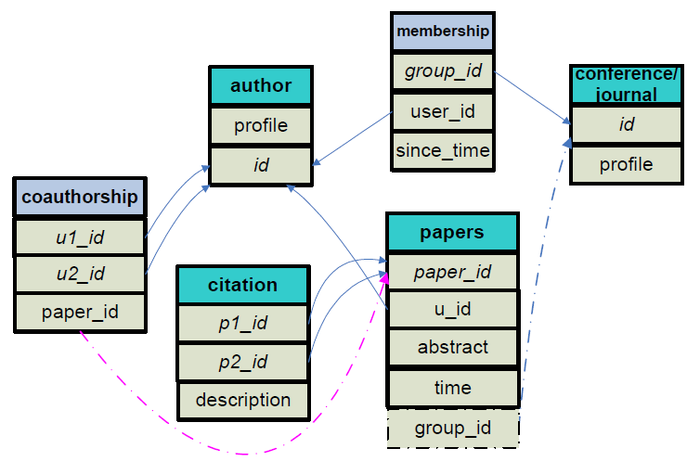
sonSchema
example instantiation: academic community
user
friendship
group
post
response2post

Slide 20
We want a data model for social networks that
(I) is supported by commercial database management systems
e.g. DB2, SQL Server, Oracle
(II) is supported by database management systems
that are affordable for social network start-ups
e.g. MySQL, PostgreSQL
(III) facilitates database schema design for social networks
(IV) facilitates database system engineering for scalability
our proposal: sonSchema
a relational database model of restricted form
(I), (II)
(III), (IV)

Slide 21
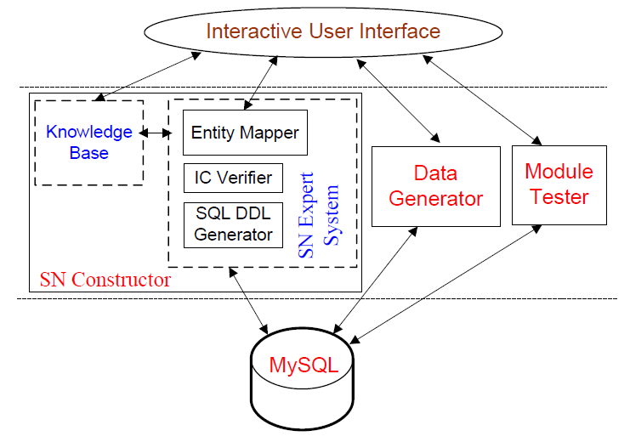
We want a data model for social networks that
(III) facilitates database schema design for social networks
architecture to automatically translate
social network design into sonSchema instantiation

Slide 22
We want a data model for social networks that
(IV) facilitates database system engineering for scalability
leverage on
sonSchema's restricted form
to efficiently find
best query plan
leverage on
sonSchema's restricted form
to design a scalable protocol
for strong consistency
result: sonSQL

Slide 23
our ambition is for sonSQL to replace MySQL
as the default database system
adopted by new social network services
http://sonsql.comp.nus.edu.sg

