Slide 1
UpSizeR Synthetically Scaling up A Given Database State
Y.C. Tay, Bing Tian Dai, Daniel T. Wang, Yuting Lin, Eldora Y. Sun
National University of Singapore

Slide 2
Motivation:
e-commerce (Amazon, eBay, Google, Yahoo!, …)
big data
social networks (Facebook, Flickr, Twitter, YouTube, …)
planning for growth requires tests with a dataset D’
that is bigger than current dataset D
D’ must be synthetic
use TPC benchmarks?
TPC-C for online transaction processing
TPC-H for decision support
TPC-W for e-commerce
…
can scale to any size
domain-specific
but not
application-specific
we want:
one tool for scaling that works for
different applications

Slide 3
Dataset Scaling Problem
Given a set of relational tables D and a scale factor s,
generate a database state D’ that is similar to D but s times its size.
statistical distribution?
graph properties?
query performance?
we want:
a general definition of similarity that is application-dependent
Assume: UpSizeR user has a set of queries Q
Definition: D and D’ are similar if the they give similar results for Q
s > 1: use D’ to test system scalability
s = 1: enterprise generates synthetic copy D’ for vendor
s < 1: small copy D’ for application testing

Slide 4
UpSizeR input:
database state = {tables}
E.g. Flickr-like database F
primary key
Photo
foreign key
Pid
PK
PUid
FK
Pdate
Psize
relation
scheme
. . .
P1 U10 Feb14 1MB . . .
P2 U10 Feb14 2MB . . .
table
P3 U77 Jan9 1MB . . .
tuples
P4 U77 Feb14 5MB . . .
P5 U43 Jan9 3MB . . .
...

Slide 5
UpSizeR input:
database state = {tables}
E.g. Flickr-like database F
Comment
Cid
PK
CPid
FK
CUid
FK
Cdate
. . .
Photo
Pid
PK
PUid
FK
Pdate
Psize
. . .
User
Tag
Uid
PK
Uname
Ulocation
. . .
Tid
PK
TPid
FK
TUid
FK
Tdate
. . .
schema graph

Slide 6
Assumptions:
(A1) Each primary key is a singleton attribute
(A2) A table has at most two foreign keys
(A3) The schema graph is acyclic
can be
relaxed
(A4) The degree distribution is static
E.g. #comments posted per user has same distribution in F and F’
(A5) A tuple’s non-key values only depend on its key values
(A6) Data correlations are not induced by a social network
not true for Flickr-like F

Slide 7
UpSizeR is based on
deg(key-value, table) :
Photo
User
Comment
Pid
PK
PUid
FK
...
Uid
PK
Uname
...
Cid
PK
CPid
FK
CUid
FK
...
y
x
x
y
y
x
y
. . .
y
y
deg(x, Comment) = 2
...
...
deg(y, Comment) = 1
deg(y, Photo) = 4
joint degree distribution :
e.g. f _{User} (d , d’) = Prob( deg(u,Photo)=d, deg(u,Comment)=d’ )
co-cluster distribution :
e.g. { Uids } = Ucluster1 U Ucluster2 U Ucluster3 U . . .
(gardeners)
(painters)
{ Pids } = Pcluster1 U Pcluster2 U Pcluster3 U . . .
(cars)
(flowers)
f _{Comment} (UclusterX , PclusterY) = Prob( CUid ε UclusterX, CPid ε PclusterY )
^{cocluster}

Slide 8
UpSizeR algorithm: Flickr example F
(1) sort (acyclic) schema graph to give table generation order:
User
Photo
Comment, Tag
(2) generate tuples for User:
# Uids in F’ = s (# Uids in F )
content generation for non-key values Uname, Ulocation, ...
recall (A5): non-key values only depend on key values
Comment
Cid
PK
CPid
FK
CUid
FK
Cdate
. . .
Photo
Pid
PK
PUid
FK
Pdate
Psize
. . .
User
Tag
Uid
PK
Uname
Ulocation
. . .
Tid
PK
TPid
FK
TUid
FK
Tdate
. . .

Slide 9
UpSizeR algorithm: Flickr example F
(1) sort (acyclic) schema graph to give table generation order:
User
Photo
Comment, Tag
(2) generate tuples for User:
# Uids in F’ = s (# Uids in F )
(3) use degree distribution from F to assign deg(u, Photo) for each Uid u
for each Uid u, generate deg(u, Photo) tuples for Photo
Photo
Pid
PK
PUid
FK
Pdate
Psize
. . .
User
Uid
PK
DONE
Uname
Ulocation
. . .

Slide 10
UpSizeR algorithm: Flickr example F
(1) sort (acyclic) schema graph to give table generation order:
User
Photo
Comment, Tag
(2) generate tuples for User:
# Uids in F’ = s (# Uids in F )
(3) use degree distribution from F to assign deg(u, Photo) for each Uid u
for each Uid u, generate deg(u, Photo) tuples for Photo
Comment
Cid
PK
CPid
FK
CUid
FK
Cdate
. . .
Photo
Pid
PK
PUid
FK
DONE
Pdate
Psize
. . .
User
Uid
PK
DONE
Tag
Uname
Ulocation
. . .
Tid
PK
TPid
FK
TUid
FK
Tdate
. . .

Slide 11
UpSizeR algorithm: Flickr example F
(1) sort (acyclic) schema graph to give table generation order:
User
Photo
Comment, Tag
(2) generate tuples for User:
# Uids in F’ = s (# Uids in F )
(3) use degree distribution from F to assign deg(u, Photo) for each Uid u
(4) use joint degree distribution from F to
correlated
for each Uid u : assign deg(u, Comment)
for each Pid p : assign deg(p, Comment)
need to co-cluster
(5) use (any) co-clustering algorithm to generate
f _{Comment} (UclusterX , PclusterY)
^{cocluster}
key values
for new
Comment
tuple t
generate new Cid c ;
assign c to some (UclusterX, PclusterY )
pick u ε UclusterX according to deg (u, Comment)
new tuple t
pick p ε PclusterY according to deg (p, Comment)
generate non-key values for t
decrement deg (p, Comment); decrement deg(u, Comment)
repeat till deg (u, Comment) = 0 and deg (p, Comment) = 0
(6) generate Tag similarly

Slide 12
Experimental Validation with Flickr
#Uid s in F2.81 = 2.81(# Uids in F1.00)
F1.00
F2.81
F5.35
dataset D
scale factor s
F9.11
#tuples
User
Photo
Comment
Tag
real
F1.00 146374 529926 1505267 3343964
synthetic
UpSizeR(F1.00, 1.00) 146372 581069 1654678 3765474
real
F2.81 410892 1557856 4234147 9198476
synthetic
UpSizeR(F1.00, 2.81) 411305 1557650 4410086 10377427
real
F5.35 783821 2803603 7709470 16299952
synthetic
UpSizeR(F1.00, 5.35) 783090 2823268 8093519 17813587
real
F9.11 1332796 4474956 18136861 27743408
synthetic
UpSizeR(F1.00, 9.11) 1333448 4693496 13702306 29637029

Slide 13
Experimental Validation with Flickr
F1: retrieve users who uploaded photographs (0 joins)
F2: retrieve photographs that are commented on by their owners (1 join)
F3: retrieve users who tagged others’ photographs (1 join)
F4: retrieve users who uploaded photographs but made no comments (2 joins)
F5: retrieve photographs tagged with “bird” (0 join)
F6: retrieve photographs tagged with “bird” and “sky” (1 join)
#tuples
F1
F2
F3
F4
F5
F6
F1.00
945
85137
2654
1
2075
120
UpSizeR(F1.00, 1.00)
906
71080
2896
0
3081
161
F2.81
2398
219499
9717
3
8448
255
UpSizeR(F1.00, 2.81)
2687
205334
8119
1
9973
474
F5.35
4369
401464
15671
4
15513
485
UpSizeR(F1.00, 5.35)
5063
406099
15751
5
17306
972
F9.11
8258
734766
27493
15
32619
1513
UpSizeR(F1.00, 9.11)
8673
717454
26686
13
31640
1746

Slide 14
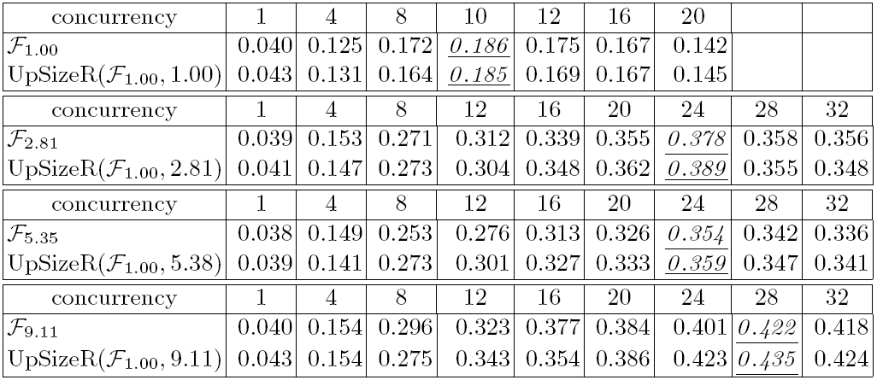
Application: using UpSizeR to test system scalability
scale out test: find Q _{S} ,
where Q _{S} is concurrency level before
throughput degrades
s 1.00 2.81 5.35 9.11
#machines 2 6 10 18
query = retrieve all photographs uploaded by a user
blob (synthetic)
randomly chosen
blobs stored in HadoopObS (similar to Haystack [Facebook])
non-blobs (relations) stored in Hadoop HDFS (similar to MapReduce GFS)
queries run with Hive (data warehouse)
UpSizeR data correctly
predicts Q_{S}
experiment: compare Fs and UpSizeR(F1.00, s), s ≥ 1

Slide 15
Conclusion:
Dataset Scaling Problem
UpSizeR is a first-cut tool for generating application-specific datasets
requires community effort
UpSizeR is open source and available
(http://www.comp.nus.edu.sg/~upsizer )
much more to do: scaling XML, logs, streams, etc.

Slide 16
advertisement
introduces basic techniques
for modeling system performance
discusses 20 papers

