Slide 1
Recursive variance partitioning: Quantifying batch effects
Chan Wei Xin (weixin@u.nus.edu)
Supervisor: Prof Wong Limsoon

Slide 2
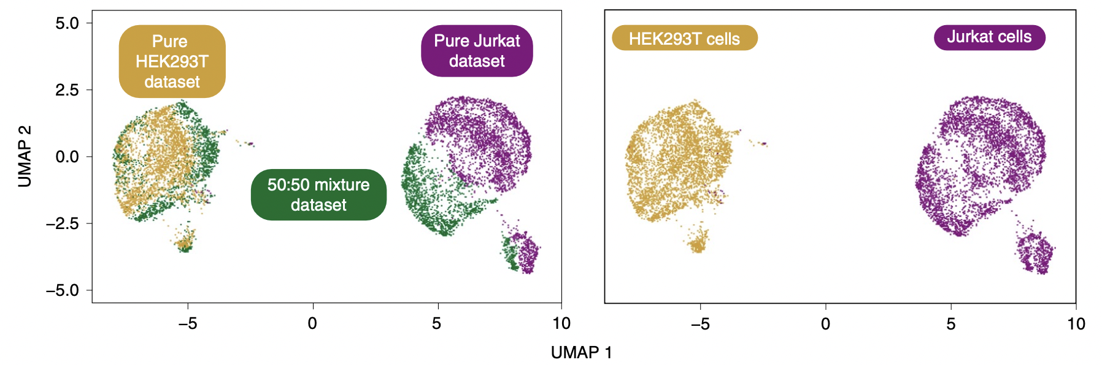
Batch effects
Adapted from: Korsunsky et al. (2019)
Identified qualitatively by visualizing data through PCA, t-SNE and UMAP
Systematic errors in measurements between different batches of samples
Can be the result of many different factors

Slide 3
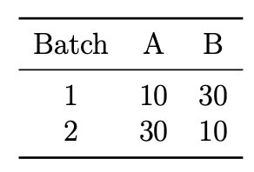
Quantifying batch effects
Few methods have been proposed for data sets with small sample sizes
  PVCA (Scherer, 2009)
  gPCA (Reese et al., 2013)
Methods designed for use in scRNA-seq data include:
  k-BET (Buttner et al., 2019)
  LISI (Korsunsky et al., 2019)
Not robust to data with batch-class imbalance
Notes:
Batch effect detection have typically been performed qualitatively
Advantages: Facilitate comparison

Slide 4
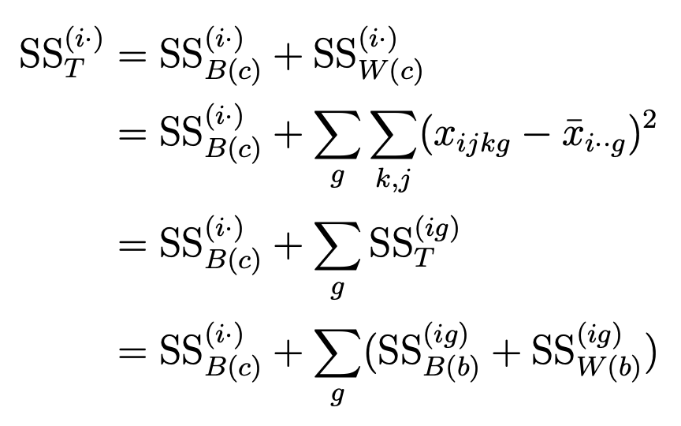
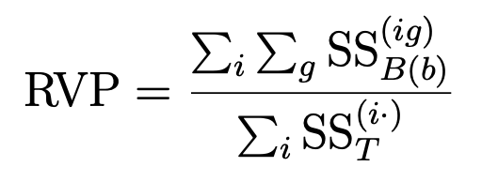
Recursive variance partitioning (RVP)
Robust to data with batch-class imbalance
Measures the percentage of variance in data due to batch effects
Based on the partition of sums of squares
Notes:
We designed a metric for batch effects which is robust to batch class imbalance..

Slide 5
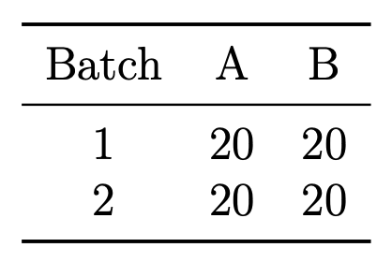
Results – Simulated RNA-seq data
BatchQC package – Raw counts are simulated using a negative binomial distribution
Simulated 11 different data sets with different magnitudes of batch effects
Two sets of data sets: Balanced and imbalanced
Theoretical variance due to batch effects can be computed using the parameters that were used to simulate the RNA-seq data
Empirical variance estimated by RVP to be due to batch effects
Notes:
- Evaluated the accuracy of our metric in measuring different magnitudes of batch effects through the use of simulated RNA-seq data
- Using the parameters used to simulate the RNA-seq data, we are able to compute the theoretical batch effects variance
- As our metric RVP measures the percentage of variance due to batch effects, we can calculate the

Slide 6
Results – Real world data
Microarray gene expression data
  Ma-Spore ALL data set
  MAQC-I data set
Quantitative proteomics data
  Westlake data set
Created balanced and imbalanced versions of these data sets by sub-sampling
Created versions of these data sets with no batch effects by assigning samples from the same batch to different “pseudo” batches

Slide 7
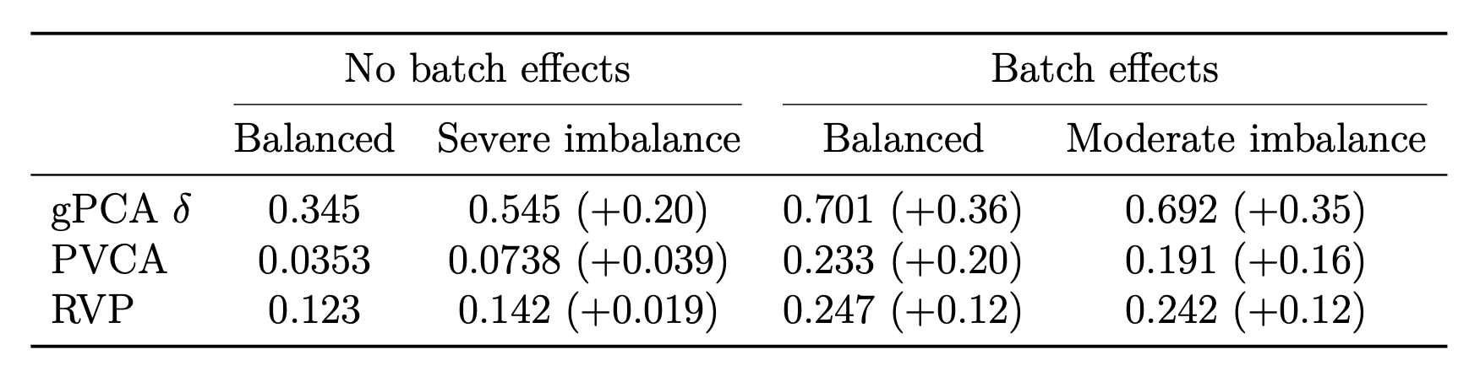
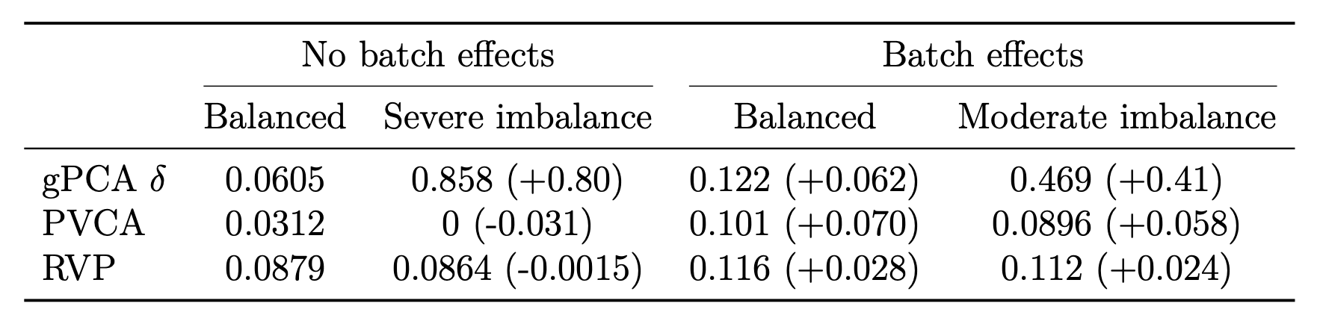
Results – Microarray data
Ma-Spore ALL data set
MAQC-I data set
Notes:
- Results from the ALL data set support results from the simulated data

Slide 8
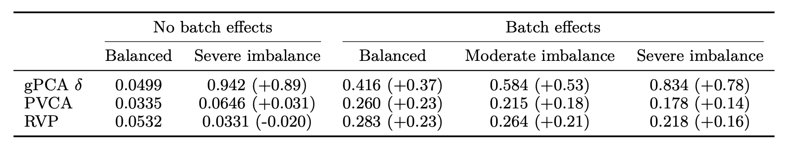
Results – Proteomics data
Westlake data set

Slide 9
Runtime
Simulated five data sets with different numbers of samples using the BatchQC package
Number of samples: 2000, 4000, …, 10000; Number of features: 8000
Notes:
In general, PCA has a cubic time complexity O(min(p^3, n^3))
RVP only involves basic arithmetic computations
RVP has a quadratic time complexity, O(pn)
8000 samples (8 s)

Slide 10
Conclusion
RVP is an estimate of the proportion of variance in data that is due to batch effects
RVP accurately quantifies the magnitude of batch effects across a wide range of magnitudes
RVP is robust even when used on data with batch-class imbalance
RVP is an order of magnitude faster than gPCA and PVCA
Future work
Compare RVP against batch effects metrics designed for scRNA-seq data
Evaluate the effectiveness of RVP in quantifying batch effects in scRNA-seq data

Slide 11
Thank you!
Q&A

Slide 12
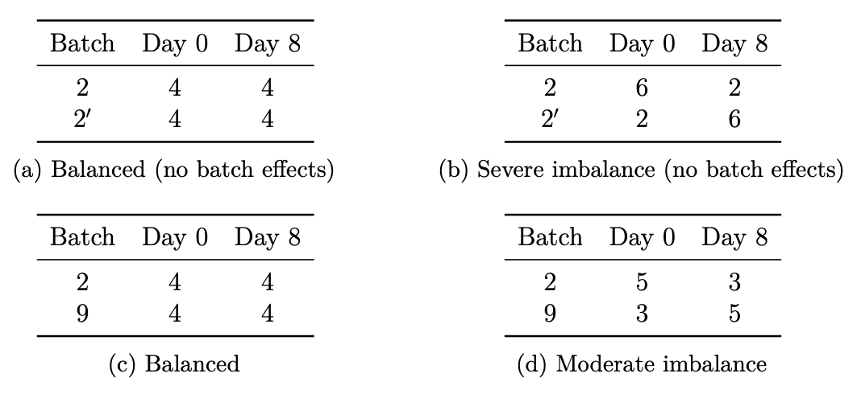
Ma-Spore ALL data set

Slide 13
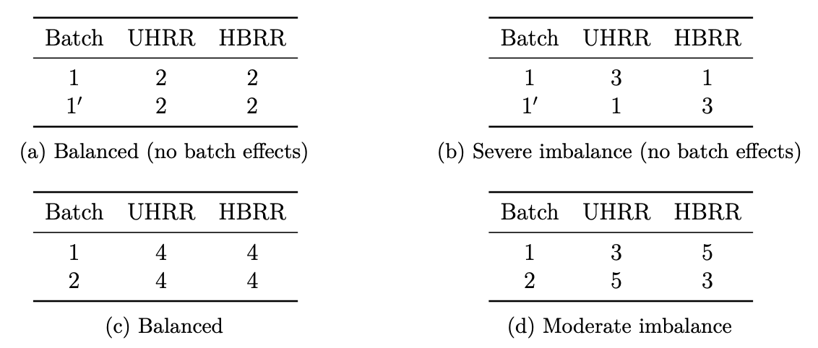
MAQC-I data set

Slide 14
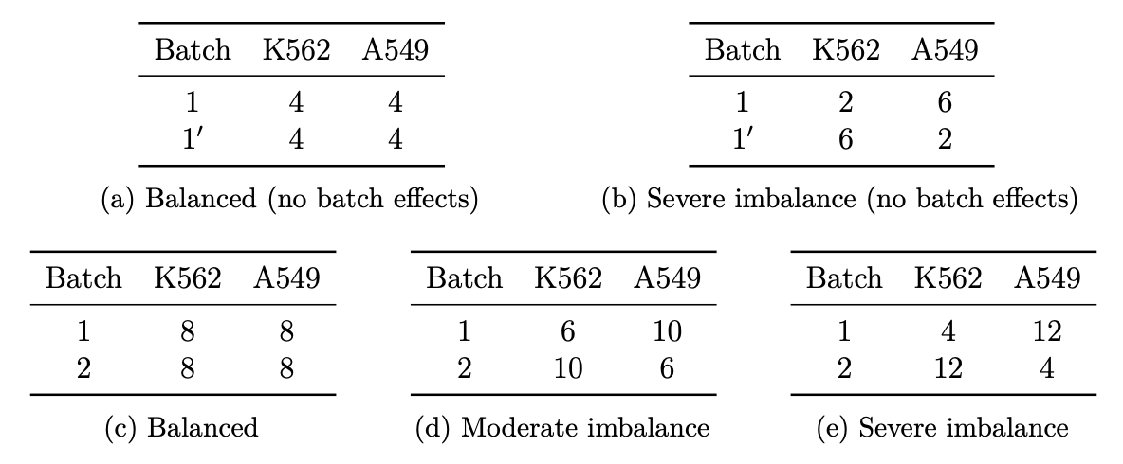
Westlake data set

Slide 15

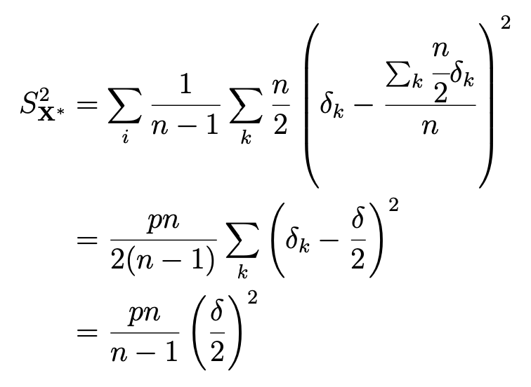
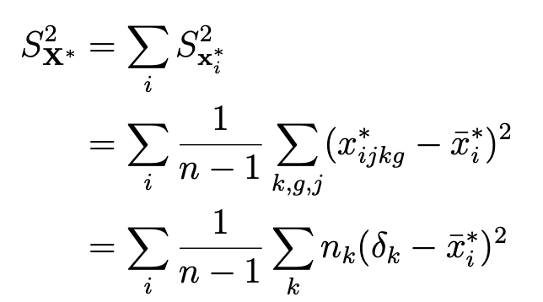
Theoretical variance due to batch effects

